Slide 1
Project on Awareness program about Digital Marketing
-By MOKSH K GOSWAMI
-ENROLLMENT NO.- CBA 15
CLASS- A

Slide 2
Problem ID: PID708 Challenge Title : Marketing and Digital Marketing Strategies for Effective market penetration Name of the Industry :
Dipti Glass work Challenge Description with context : To resolve the problem at a entry level in convincing the customers to buy products instead of existing vendors. The pinch point of the Industry is how the newly emerging company can penetrate the market effectively and sustain in the market. Users : All new emerging Industries Expected
Outcomes : The newly emerging businesses and start-ups will establish and scale up in market. Impact : Industries facing similar issues will have an effective solution of market penetration.

Slide 3
MODULES USED IN PROJECT
"AM" -for affiliate marketing
"smm"- social media marketing
"EM"-Email marketing
"CM"-Content Marketing
"SEO"- Search Engine Optimisation

Slide 4
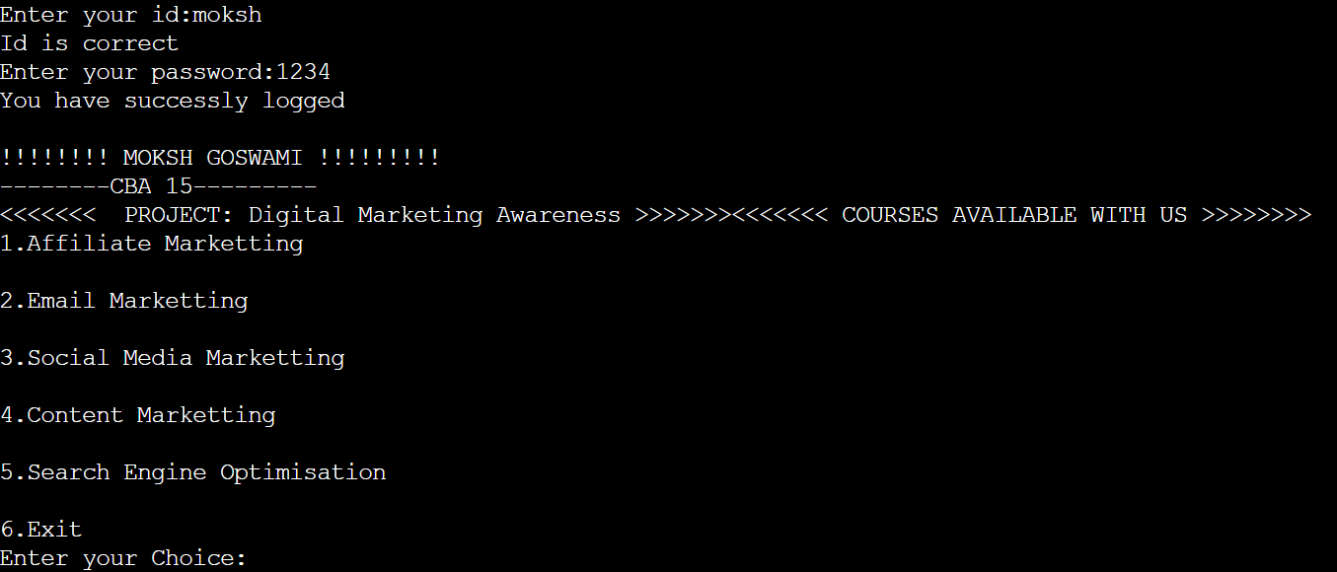
Main Page

Slide 5
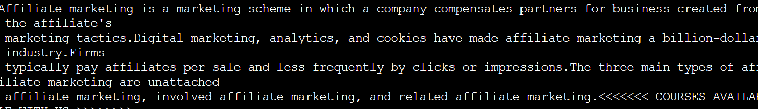
Affiliate Marketing

Slide 6
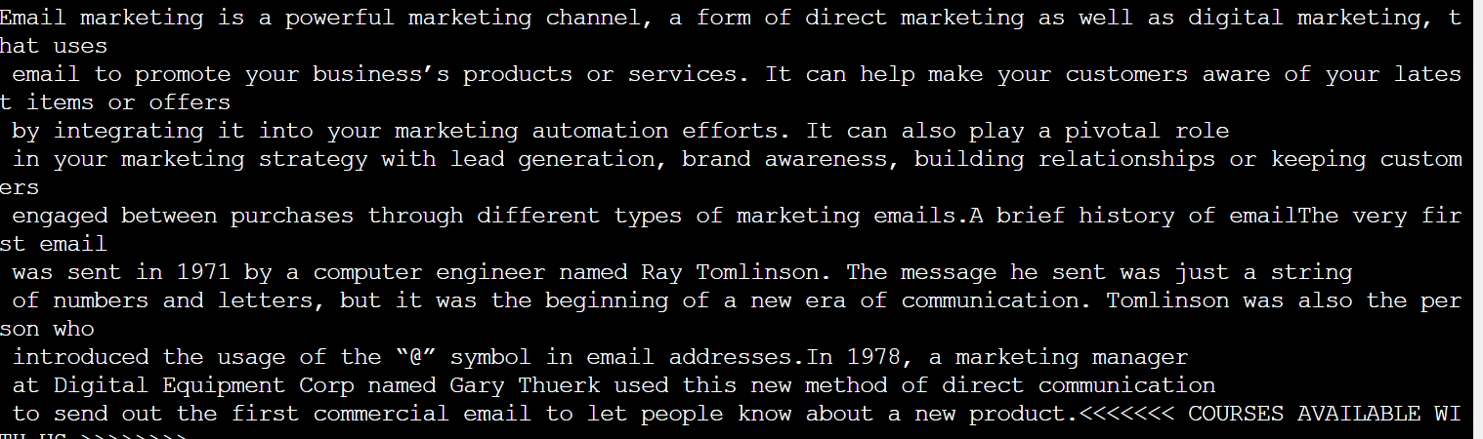
Email Marketing

Slide 7
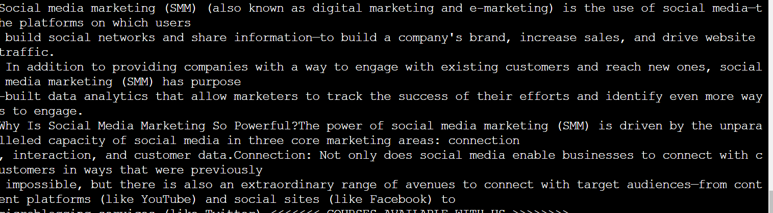
Social Media Marketing

Slide 8
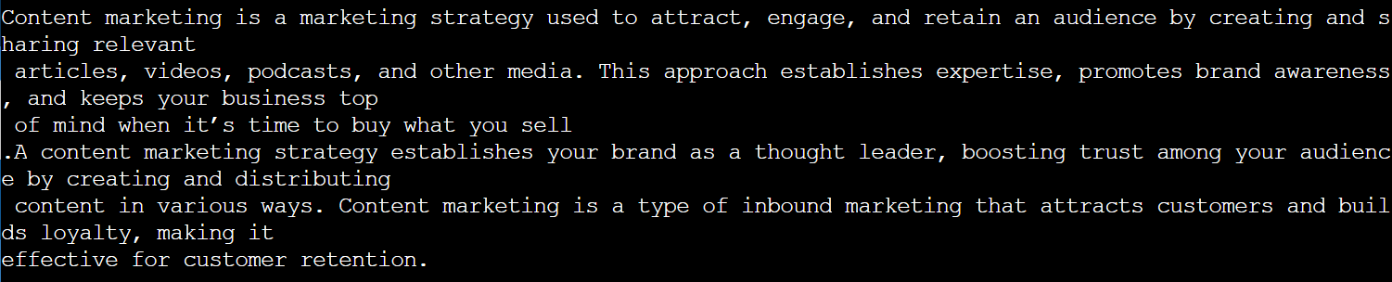
Content Marketing

Slide 9
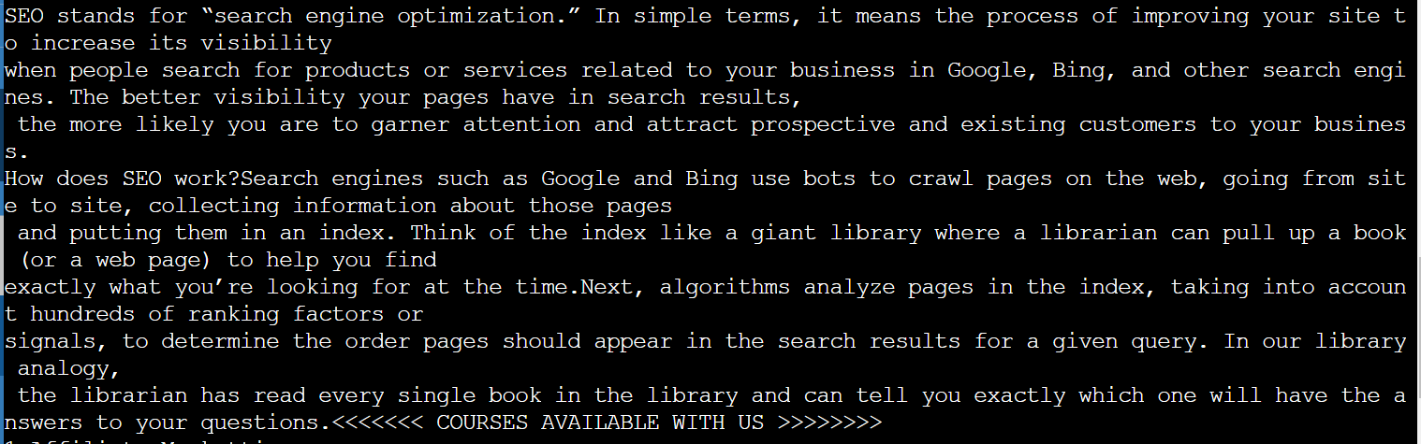
Search Engine Optimization

Slide 10
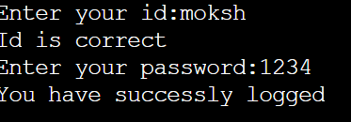
LOGIN

